Slide 1
Unit III: Peripheral Devices and their Interfacing: Introduction to memory interfacing and various interfacings chips like:
1.Programmable input/output ports 8155/8255
2.Programmable interval timer 8253/8254
3.keyboard/display controller 8279
4.Programmable communication interface 8251 USART
5.Programmable interrupt controller 8259
6. DMA controller 8257.

Slide 2
PPI : 8255
It is a programmable peripheral interfacing device.
It has 24 I/O programmable pins for PA,PB,PC and has three distinct modes of operation

Slide 3
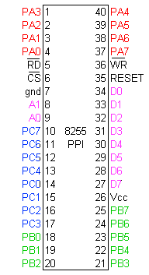
Pin Diagram

Slide 4
Function of pins:
Data bus(D₀-D₇):These are 8-bit bi-directional buses, for transferring data.
CS: This is Active Low signal. When it is low, then data is transfer.
Read: This is Active Low signal, when it is Low read operation will be start.
Write: This is Active Low signal, when it is Low Write operation will be start.

Slide 5
Address (A₀-A₁):This is used to select the ports. like this
A1 | A0 | Select
0 | 0 | PA
0 | 1 | PB
1 | 0 | PC
1 | 1 | Control reg.

Slide 6
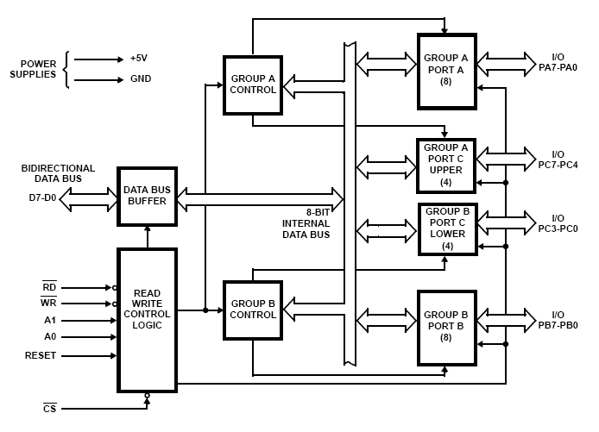

Slide 7
8255 Programmable Peripheral Interface
Data bus
D[7:0]
PA[7:0]
A0
8085
A1
PB[7:0]
RD
Control port
8255
WR
PC[7:0]
RESET
A7
CS
A6
A5
A4
A3
A2
A1 A0
Port
IO/M
0 0
0 1
0
1 1
PA 9CH
PB 9DH
PC 9E
Control word 9F
A7 A6 A5 A4 A3 A2 A1 A0
1 0 0 1 1 1 1 1

Slide 8
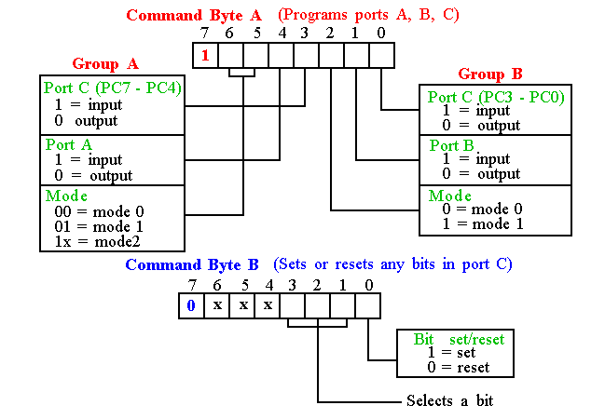
Programming 8255
WRITE a control word for I/O mode SUCH THAT PA= input
PB = output and mode =0,PC =0UTPUT
10010000 = 90H
1 0 0 1 0 0 0 0 90H
MVI A,90H
OUT 9F H
IN 9C H
CMA
OUT 9D H
OUT 9EH
HLT

Slide 9
Programming 8255
Mode 0:Simple IO Mode
Ports A, B, and C can be individually programmed as input or output ports
Port C is divided into two 4-bit ports which are independent from each other
Mode 1:
Ports A and B are programmed as input or output ports
Port C is used for handshaking
PA[7:0]
PA[7:0]
PC4
STB_{A}
PC7
OBF_{A}
PC5
IBF_{A}
PC6
ACK_{A}
PC3
INTR_{A}
PC3
INTR_{A}
8255
PB[7:0]
8255
PB[7:0]
PC2
STB_{B}
PC2
OBF_{B}
PC1
IBF_{B}
PC1
ACK_{B}
PC0
INTR_{B}
PC0
INTR_{B}
PC6, 7
PC4, 5

Slide 10
Programming 8255
Mode 2:
Port A is programmed to be bi-directional
Port C is for handshaking
Port B can be either input or output in mode 0 or mode 1

Slide 11
8255 Examples

Slide 12
The 8255A is a general purpose programmable I/O device designed to transfer the data from I/O to microprocessor and vice versa.
It consists of(24 I/O lines) three 8-bit bidirectional I/O ports which can be configured as input and output per the requirement.

Slide 13
Ports of 8255A
8255A has three ports, i.e., PORT A, PORT B, and PORT C.
Port A contains one 8-bit output latch/buffer and one 8-bit input buffer.
Port B is similar to PORT A.
Port C can be split into two parts, i.e. PORT C lower (PC0-PC3) and PORT C upper (PC7-PC4) by the control word.
These three ports are further divided into two groups,
Group A includes PORT A and upper PORT C.
Group B includes PORT B and lower PORT C.

Slide 14
Operating Modes
8255A has three different operating modes −
Mode 0 − In this mode, Port A and B is used as two 8-bit ports and Port C as two 4-bit ports.
Mode 1 − In this mode, Port A and B is used as simple 8-bit I/O ports.
-Each port uses three lines from port C
as handshake signals.
Mode 2 − In this mode, Port A can be configured as the bidirectional port
- Port B either in Mode 0 or Mode 1.
- Port A uses Port C for handshake signals.

Slide 15
Examples
Find out the port address of PA,PB,PC,CWR and also determine the control word to read the input port A and display the result to port B.

Slide 16
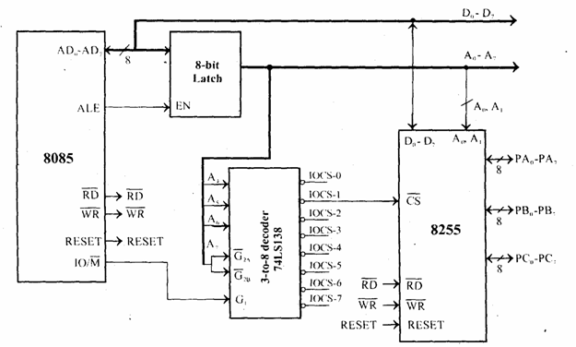
Interfacing circuit for 8255
Input address lines to decoder is A6 A5 A4 and A7 is connected to ground
Where as A0 and A1 is connected to 8255

Slide 17
The 8255 can be either memory mapped or I/O mapped in the system. In the schematic shown in above is I/O mapped in the system.
Using a 3-to-8 decoder generates the chip select signals for I/O mapped devices.
The address lines A4, A5 and A6 are decoded to generate eight chip select signals (IOCS-0 to IOCS-7) and in this, the chip select IOCS- 1 is used to select 8255.
The address line A7 and the control signal IO/M (low) are used as enable for the decoder.
The address line A0 of 8085 is connected to A0 of 8255 and A1 of 8085 is connected to A1 of 8255 to provide the internal addresses.
The data lines D0-D7 are connected to D0-D7 of the processor to achieve parallel data transfer.

Slide 18
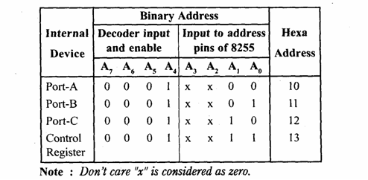
The I/O addresses allotted to the internal devices of 8255 are listed in table.

Slide 19
Example 2:The circuit have an input device like a set of 8 nos. of DIP switch and an output device like a set of 8 nos. of LED. Now we wish to arrange a circuit that can read the switch status (basically ON & OFF) and display it on LED’s
Write an ALP to read switch status form 8255 port A and reflect this binary status in LED’s which are connected in port B.
Design a interfacing circuit with 8255 for 8085 such that the port address es are :-
PA 80H
PB 81 H
PC 82H
CWR 83H

Slide 20
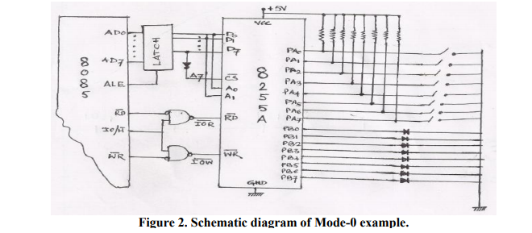

Slide 21


Slide 22
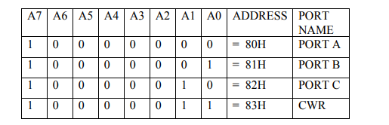

Slide 23
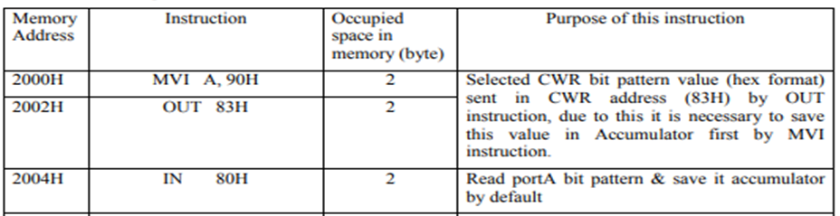
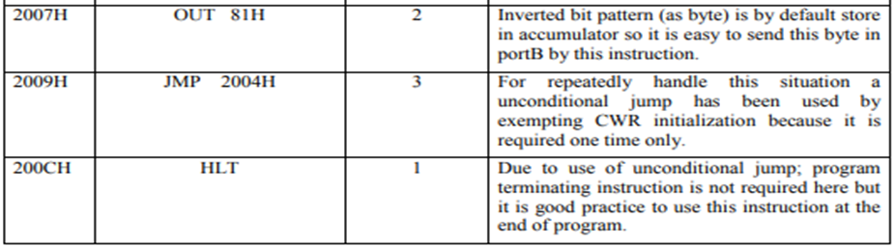

Slide 24
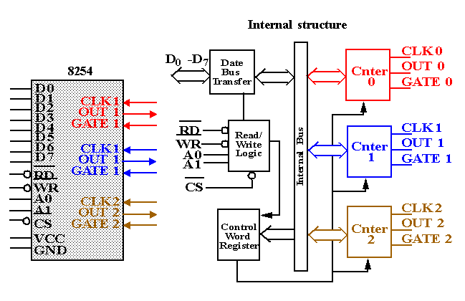
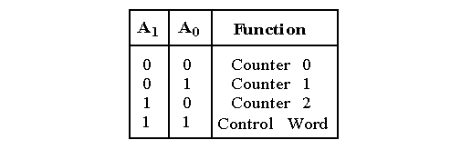
Programmable Timer 8254

Slide 25
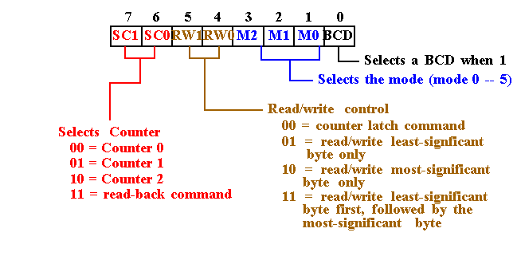
8254 Programming

Slide 26
8254 Programming
Each counter may be programmed with a count of 1 to FFFFH.
Each counter has a program control word used to select the way the counter operates.

Slide 27
8254 Read Back Command
8254 Read Back Command
1
1
COUNT
STATUS
CNT2
CNT1
CNT0
0
8254 status word format
OUTPUT
NULL
COUNT
RW1
RW0
M2
M1
M0
BCD
NULL COUNT: goes low when the new count written to a counter is actually loaded into the counter

Slide 28
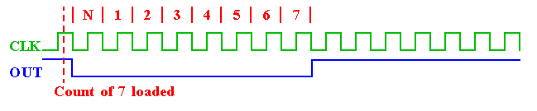
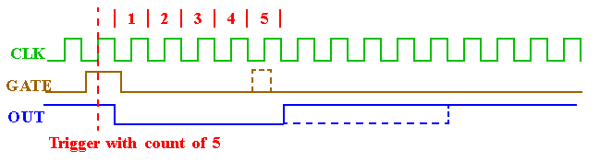
8254 Modes
Mode 0: An events counter enabled with G.
  The output becomes a logic 0 when the control word is written and remains there until N plus the number of programmed counts.
Mode 1: One-shot mode.
  The G input triggers the counter to output a 0 pulse for `count' clocks.
  Counter reloaded if G is pulsed again.

Slide 29
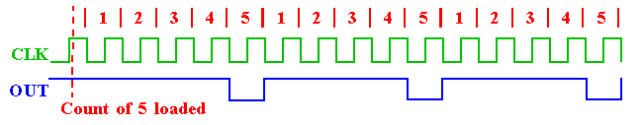
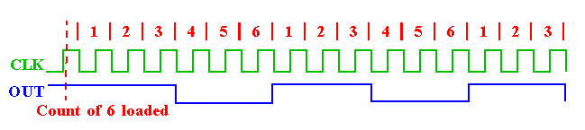
8254 Modes
Mode 2: Counter generates a series of pulses 1 clock pulse wide.
  The seperation between pulses is determined by the count.
  The cycle is repeated until reprogrammed or G pin set to 0.
  Mode 3: Generates a continuous square-wave with G set to 1.
    If count is even, 50% duty cycle otherwise OUT is high 1 cycle longer.

Slide 30
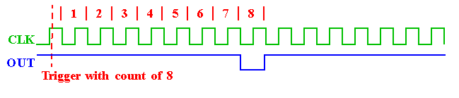
8254 Modes
Mode 4: Software triggered one-shot
  (G must be 1).
Mode 5: Hardware triggered one-shot. G controls similar to Mode 1.

